Slide 1
EE451: High Voltage Engineering
Lecture 10
May 23, 2016

Slide 2
Outline
Breakdown Mechanism in Gases
Time Lags for Breakdown
Townsend’s Breakdown Mechanism
Drawbacks of Townsend’s Theory
Streamer (or kanal) Theory of Breakdown in gases
Complete Mechanism of Gas Breakdown
Page 2

Slide 3
Time Lags for Breakdown
A gaseous dielectric cannot breakdown at the instant when the electric stress exceeds its breakdown value.
Actually, there is a time difference between the application of a voltage sufficient to cause breakdown and the occurrence of breakdown itself. This time difference is called the time lag.
Townsend criterion for breakdown is satisfied, only if at least one electron is present in the gap between the electrodes.
In the case of applied d.c. or slowly varying (50 Hz a.c) voltages, there is no difficulty in satisfying this condition. The reason being that the duration of a.c. and d.c. voltages is sufficiently large so that there are usually sufficient initiatory electrons created by cosmic ray and naturally occurring radioactive sources.
Page 3

Slide 4

Time Lags for Breakdown
However, with rapidly varying voltages of short duration (~ 10⁻⁶ s), the initiatory
electron may not be present in the gap, and in the absence of such an electron breakdown cannot occur.
The time t which lapses between the application of the voltage sufficient to cause breakdown and the appearance of the initiating electron is called a statistical time lag (t_{s}) of the gap.
After the appearance of the electron, a time is required for the ionization processes to fully develop and cause the breakdown of the gap, and this time is called the formative time lag (t_{f}).
The total time lag is the addition of statistical and formative time lag.
Page 4

Slide 5
Townsend’s Breakdown Mechanism
Townsend’s mechanism of spark breakdown is based on the successive generation of series of avalanches originating from the cathode surface, aided by the primary and secondary ionization processes.
These electron avalanches extends all over the area of the gap and ultimately constricts into a spark, flashover or breakdown by giving rise to a highly conductive channel in which both electrons and ions flow to achieve the required magnitude of current for breakdown.
This leads to the complete loss of insulating properties of the gas.
Page 5

Slide 6
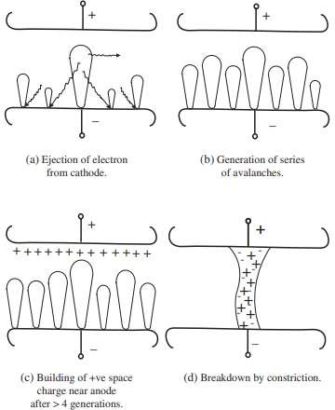
Townsend’s Breakdown Mechanism
Page 6

Slide 7
Drawbacks of Townsend’s Theory
Townsend’s breakdown mechanism can be applied only for relatively low pressures and short gaps up to 4 cm (that is, pd < 200 Torr.cm).
When Townsend theory is applied to the breakdown of gases at atmospheric pressure, it suffered certain drawbacks:
According to Townsend’s theory, the current growth occurs as a result of ionization processes only. However, in practice, breakdown voltages were found to be dependent on the gas pressure and geometry of the gap.
Towsend’s theory predicts the time lags for spark breakdown of the order of 10⁻⁵ s, whereas in actual practice, breakdown at high pd and considerable overvoltage was observed to occur at very short times of the order of 10⁻¹⁰ s.
Page 7

Slide 8
Streamer (or Kanal) Theory of Breakdown in Gases
In 1940, Raether, Meek and Loeb independently proposed streamer mechanism of breakdown.
Townsend mechanism of spark breakdown is based on the generations of a series of avalanches.
However, the streamer breakdown mechanism describes the development of spark breakdown directly from a single avalanche which the space charge transforms into a plasma streamer.
Thus, the conductivity of the gap grows rapidly, and breakdown occurs through its channel.
Page 8

Slide 9
Streamer (or Kanal) Theory of Breakdown in Gases
An avalanche consists of a number of charged particles, i.e., electrons and positive ions.
The drift velocity of electrons is about 150 times greater that of the ions:
Electrons ~ 10⁷ cm/s
Positive ions ~ 10⁵ cm/s
Therefore, as soon as the avalanche is formed, the positive ions remain practically stationary where they are produced, i.e., at the tail of the avalanche. The head of the avalanche is consequently built up by electrons.
The form of the track is wedge shaped, apparently due to the thermal diffusion of the drifting electron swarm having acceleration in the direction of electric field.
The head of the avalanche is rounded since the diffusion of electrons takes place in all directions.
Page 9

Slide 10
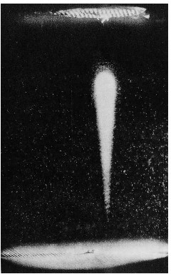
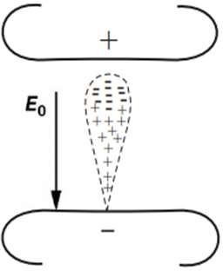
Streamer (or Kanal) Theory of Breakdown in Gases
An Electron avalanche in uniform field
Distribution of charge carriers and the shape
Actual photograph of an avalanche by Raether
Page 10

Slide 11
Streamer (or Kanal) Theory of Breakdown in Gases
When the experiments were conducted in a uniform electric field with longer gap distances, the size of the avalanche to be able to develop in the gap also increases.
Since, an avalanche consists of a number of charged particles (electrons at the head and positive ions at the tail), the number of charged particles also increase.
As the number of charged particles segregate, they make a cluster. So, space charge is being formed, i.e., accumulation of like-polarity charges.
When the charged particles accumulate, they form their own electric fields. Now, we have to take into consideration two electric fields:
Applied electric field E₀
Electric field developed within the avalanche E_{a}

Slide 12
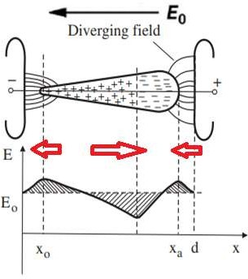
Streamer (or Kanal) Theory of Breakdown in Gases
During the experiments, it was observed that the number of charge carriers in the avalanche, that is the space charge, was insufficient to cause a distortion in the applied electric field E₀ for small gap distances.
However, when the total number of electrons reach 10⁷ to 10⁸, the space charges of ions and electrons in the avalanche become strong enough to distort the applied electric field E₀.
Figure shows the distortion of electric field due to the interaction between space charges and the polarities of the electrodes.

Slide 13
Streamer (or Kanal) Theory of Breakdown in Gases
Following conclusions can be drawn:
Compared with the applied field E₀, the field intensity at the head and the tail of the avalanche is increased due to the presence of space charges.
Within the avalanche, the field intensity is reduced between the opposite polarity electrons and ion clouds.
The field intensities toward the head and the tail of avalanche acquire a magnitude (E₀ + E_{a}), while above the positive ion region, just behind the head, the field is reduced to a value (E₀ - E_{a}).
The enhancement of field intensity at the head and the tail of an avalanche may initiate a new type of discharge process, known as streamer (or Kanal) mechanism.

Slide 14
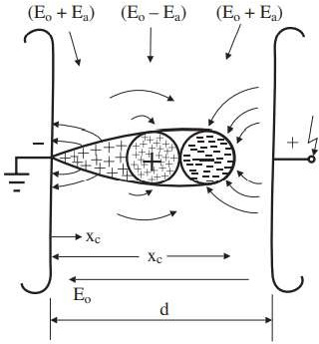
Streamer (or Kanal) Theory of Breakdown in Gases
Effect of space charge field E_{a} of an avalanche of critical amplification on the applied uniform field E₀

Slide 15
Streamer (or Kanal) Theory of Breakdown in Gases
Under this condition, the ionization process proceeds at a higher rate at the front and the tail of the avalanche, but at a lower rate at the center.
At this stage, the rate of advancement of the avalanche towards the anode increases by the generation of fresh avalanches because of the enhanced fi eld intensity in the upper region.
New electrons in the vicinity of the primary avalanche produce fresh avalanches. These new electrons could be produced by photo ionization, caused by the primary avalanche.
The new avalanches thus formed at the head of the primary avalanche are known as “secondary avalanches”. This development is known as “anode-directed streamer”.

Slide 16
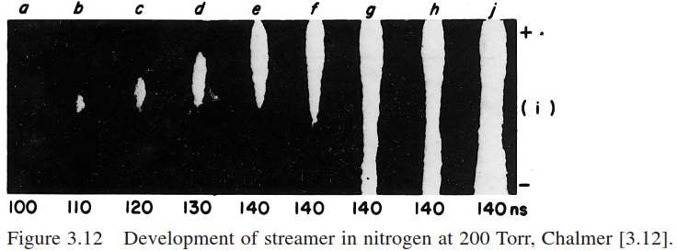
Streamer (or Kanal) Theory of Breakdown in Gases
Simultaneously, at the tail of the primary avalanche, a favorable condition arising due to positive ion space charge extends the ionization process backwards, giving rise to the “cathode-directed streamer”.
Obviously, this requires sufficient number of electrons also at the cathode side of the primary avalanche.

Slide 17
Streamer (or Kanal) Theory of Breakdown in Gases
According to Raether and Meek, when the avalanche has crossed the gap, the electrons are swept into the anode and the positive ions remaining in a cone-shaped volume extend across the gap.
A highly localized space charge field due to positive ions is produced near the anode
but since the ion density elsewhere is low, it does not constitute a breakdown in the gap.
In the gas surrounding the avalanche, secondary electrons are produced by photons from the highly ionized gas and photoelectric effect at the cathode.
Under the influence of the electric field, these secondary electrons develop into secondary avalanches which are directed toward the stem of the main avalanche.

Slide 18
Streamer (or Kanal) Theory of Breakdown in Gases
These secondary avalanches feed the into primary avalanche, that is, the new electrons produced in the gap feed the charged particles to the primary avalanche since the charged particles always follow the least resistance path.
In this way, more and more secondary avalanches feed into the primary avalanche, since an avalanche is conducting.
Finally, the positive ions left behind by the secondary avalanches effectively lengthen and intensify the space charge of the main avalanche in the direction of the cathode.
The process thus develops in the form of a self-propagating streamer, which effectively extends the anode towards the cathode .
Ultimately, a conducting filament of highly ionized gas bridges the whole gap between the electrodes.

Slide 19
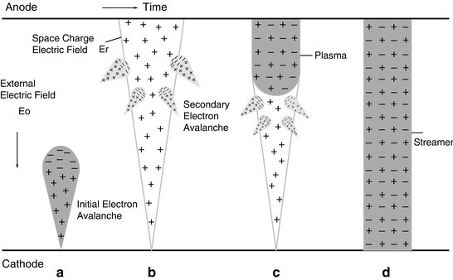
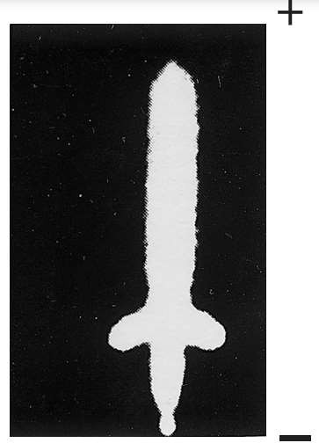
Streamer (or Kanal) Theory of Breakdown in Gases
(a) Avalanche is formed (b) avalanche crossing the gap (b) streamer extending from anode (c) streamer crossing the gap

Slide 20



Streamer (or Kanal) Theory of Breakdown in Gases
It has been observed through measurement that the transformation from avalanche to streamer generally takes place when the number of charge carriers within the avalanche head reaches a critical value of:
where x_{c} is the length of an avalanche in the field direction when it amplifies to its critical size, that is, x_{c} is the critical length of the electrode gap d_{c}.
For an avalanche initiated by a single electron (n₀ = 1) in a uniform field, this corresponds to a value,
Page 20

Slide 21
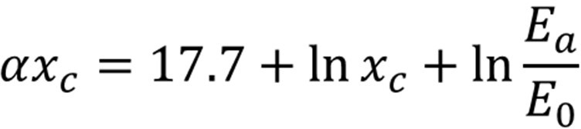

Streamer (or Kanal) Theory of Breakdown in Gases
It implies that the streamer mechanism is possible only when d ≥ x_{c} . If x_{c} is longer than the gap length d (x_{c} > d), then the initiation of streamer is unlikely.
On the bases of experimental results, Raether proposed an empirical relation for the streamer breakdown criterion of the form:
The condition for transition from series of avalanche to streamer breakdown assumes that this eigen space charge field approaches nearly equal to the externally applied field (E_{a} ≈ E₀). Hence, the criterion for breakdown becomes,
Page 21

Slide 22


Streamer (or Kanal) Theory of Breakdown in Gases
The minimum value of αx_{c} required for breakdown in a uniform field gap by streamer mechanism is obtained on the assumption that the transition from avalanche to streamer occurs when an avalanche of critical size just extends across the gap d_{c}.
By incorporating this condition, the criterion for streamer breakdown takes the form,
Thus, the condition x_{c} = d_{c} gives the smallest value of α to produce streamer breakdown, where d_{c} is given in cm.
For αx_{c} = ln10⁸, x_{c} works out to be equal to 2.01 cm.
Page 22

Slide 23
Streamer (or Kanal) Theory of Breakdown in Gases
Hence, a gap distance of 2 cm between the uniform field electrodes can be considered as minimum or critical gap distance d_{c} for streamer phenomenon to take place in atmospheric air.
The “streamer breakdown criterion” can therefore be interpreted as a condition for the development of significant field distortions caused by stark space charges within a single avalanche so that its eigen field intensity is comparable to the externally applied field.
Page 23

Slide 24
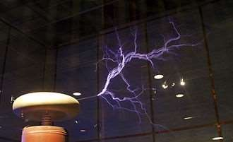
Streamer (or Kanal) Theory of Breakdown in Gases
Page 24

Slide 25
Complete Mechanism of Gas Breakdown
Leader
Ionization
Avalanches
Streamer
Spark
Arc
Page 25

Slide 26
Complete Mechanism of Gas Breakdown
When a gas is subjected to high voltage stress, a number of electrons and positive ions are produced due to the process of ionization in the gap.
These charged particles take the shape of an avalanche. The avalanches create ionized, electrically conductive regions in the air near the electrode creating the electric field.
The space charges created by the electron avalanches gives rise to an additional electric field. This field can enhance the growth of new avalanches in a particular direction.
Then the ionized region grows quickly in that direction, forming a finger-like discharge originating from stressed electrode called a streamer.
Page 26

Slide 27
Complete Mechanism of Gas Breakdown
Streamers are electron avalanches typically lasting for few ns. Hence, a streamer discharge is a type of transient electrical discharge.
The word “streamer” means a ribbon attached at one end and floating or waving at the other in wind. When a number of such long narrow strips wave together, they appear to be a set of waves or ripples moving forward.
Streamers attract multiple electron avalanches into a single channel, propagating forward quickly via photon emission which leads to photoelectrons producing new avalanches.
Streamers redistribute charge within the surrounding gas, temporarily forming regions of excess charge (space charges) in the regions surrounding the discharges.
Page 27

Slide 28
Complete Mechanism of Gas Breakdown
If the electrical field is sufficiently high, the individual currents from one of the streamers of multiple streamers combine to create a hot, highly conductive path that projects from the electrode, going some distance into the gap.
The projecting channel of hot plasma is called a leader, and it can have an electrical conductivity approaching that of an electric arc.
When the leader has reached the surface of the electrode, a spark occurs which can bridge the gap and high current of the order of short circuit current flows through the gap.
Final stage of spark is arc in which high current flows and breakdown occurs.
Page 28

Slide 29
THANK YOU FOR YOUR ATTENTION

